Slide 1

Marshee Smart Tracker: Enhancing Wellness Through Data
This presentation details the data collection, model development, and deployment strategy for the Marshee Smart Tracker, a device designed to monitor and improve pet activity levels. We'll explore the steps involved in transforming raw sensor data into actionable insights, focusing on how these insights can contribute to better pet health and well-being.
From data collection and preprocessing to model integration and deployment, we'll cover the entire pipeline. This will include feature engineering, model selection, and real-time inference, ensuring optimal performance and accuracy. Finally, we'll touch upon additional considerations such as real-time processing challenges, security and privacy, and AI-driven features.

Slide 2
Data Collection & Preprocessing: Laying the Foundation
Collection Pipeline
Normalization & Feature Engineering
The Marshee Smart Tracker contains an accelerometer that captures motion data along X, Y, and Z axes, sampled at a fixed frequency (50-100Hz). Raw data undergoes initial filtering via low-level firmware, is buffered, and then transmitted via BLE to the app, which forwards it to cloud storage.
Normalization methods include Min-Max scaling and Z-score standardization. Feature engineering includes time-domain (mean, variance), frequency-domain (FFT coefficients), statistical (correlation between axes), and derived metrics (jerk, step impact force).
Noise Identification & Cleaning
Additional Useful Features
Noise sources include motion artifacts, sensor drift, battery fluctuations, and environmental interference. Cleaning techniques involve low-pass filtering, median filtering, moving average smoothing, Kalman filtering, and signal decomposition via Wavelet transform.
Activity duration, step frequency, rest periods, step symmetry, terrain type estimation, activity intensity classification, diurnal pattern analysis, owner interaction periods, and environmental context via GPS.

Slide 3



Model Development: From Algorithms to Actionable Insights
Model Selection
Feature Selection
Training & Validation
Start with a Random Forest classifier due to its ability to handle non-linear relationships, robustness to outliers, feature importance measures, lightweight deployment, and reduced overfitting. Consider LSTM networks and 1D CNNs for more complex temporal patterns.
Use filter methods like correlation analysis and ANOVA F-value. Wrapper methods include Recursive Feature Elimination. Embedded methods involve L1 regularization and feature importance from tree-based models.
Split the dataset into 70% training, 15% validation, and 15% testing. Employ 5-fold cross-validation on training data. Tune hyperparameters using grid search or Bayesian optimization for optimal performance.
The key is to balance model complexity with the need for real-time processing and energy efficiency on the device.

Slide 4
Performance Evaluation: Metrics that Matter
Accuracy
1
Overall correctness (suitable if classes are balanced)
F1-score
2
Harmonic mean of precision and recall (for imbalanced data)
Confusion matrix
3
Visualize classification performance
In addition to Accuracy, F1-score, and the Confusion Matrix, consider ROC-AUC (Model's discriminative ability), Precision-Recall curves (Performance across different thresholds), Mean Absolute Error (For regression tasks like step count), Latency and resource usage (Critical for embedded deployment).
These metrics collectively provide a comprehensive view of the model's capabilities and limitations. Selecting the most relevant metric will depend on the specific application requirements and the nature of the dataset.

Slide 5



Integration with Firmware & App: Bridging the Gap
Optimized Format
2
Convert to TensorFlow Lite or ONNX
Model Quantization
1
Reduce model size (16-bit or 8-bit precision)
Split Processing
Basic extraction on device, complex inference in cloud
3
Real-time inference involves on-device processing using a sliding window approach and batch processing to optimize power consumption. Cloud processing can stream pre-processed features when connectivity allows, returning inference results to the device. Implement fallback local models for offline operation. Visual dashboards offer daily step count trends and activity patterns.

Slide 6
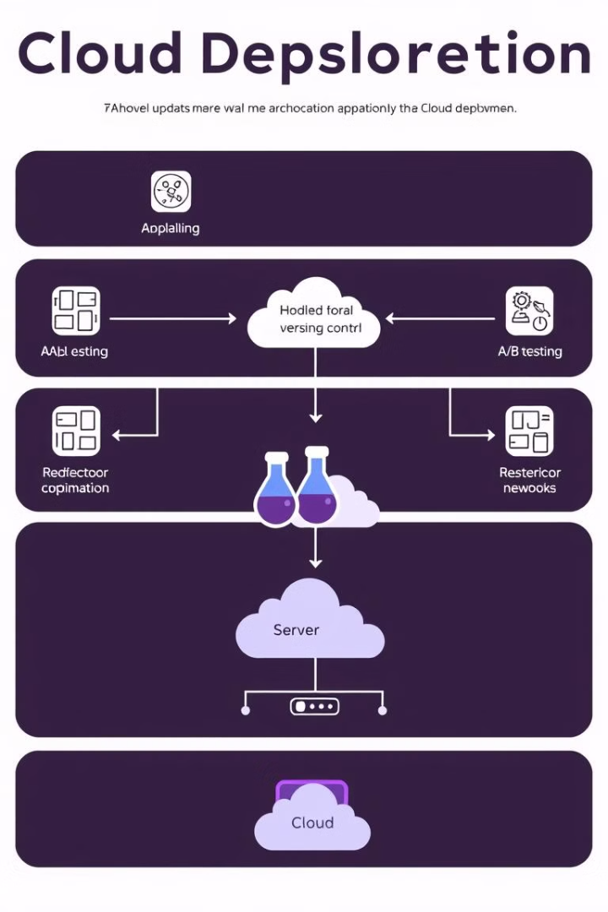



Deployment Strategy: Ensuring Smooth Transitions
OTA Update Pipeline
Cloud-based Inference Architecture
Model validation in staging, version control, delta updates, staged rollout, A/B testing, and automatic fallback mechanisms. Separate model parameters from inference logic for efficient updates.
Leverage serverless architecture for scalability. Use API Gateway, Lambda Functions, and container-based deployment. Message queuing for asynchronous processing and edge computing nodes to reduce latency.
Periodic Retraining Strategy
Automated data collection, anomaly flagging, scheduled retraining, continuous evaluation, drift detection, active learning, model versioning, and performance tracking.

Slide 7
Additional Considerations: Real-time Processing Challenges
Battery Life
Processing Latency
Adaptive sampling rates based on activity, event-triggered processing, and sleep mode optimization are crucial. This will allow the tracker to monitor activity for longer periods without needing to be charged.
Prioritize critical features, optimize algorithm complexity, and consider hardware acceleration. It is key to ensure the smart tracker can provide real-time feedback to the pet owner.
Memory Constraints
Use circular buffers for data management, feature extraction to reduce raw data storage needs, and incremental learning approaches. These can help to keep memory usage low even with large amounts of data.
Security and privacy should be also taken into consideration when developing the smart tracker. On-device processing should be used to minimize data transmission and data anonymization techniques should be applied.

Slide 8



AI-driven Features: Enhancing Pet Well-being
Anomaly Detection
1
Limp or gait irregularity identification
Fitness Recommendations
2
Personalized exercise goals
Behavior Analysis
3
Sleep quality assessment
In summary, the Marshee Smart Tracker offers comprehensive data collection, robust model development, and seamless integration to improve pet wellness. By addressing real-time processing challenges and prioritizing security, it delivers actionable insights and enhances the lives of our furry friends through AI-driven features. This makes it a game-changer in the pet care industry.

